Slide 1
CARDIOVASCULAR DISEASE
Dr. Reshma Reghu
Assistant Professor

Slide 10
Case fatality rate: Proportion of attack that are fatal within 28 days of onset. Datas suggest that 25 – 28 percent who suffer a heart attack die suddenly. 55 percent of all cardiac death mortality occurs within first hour.
Measurement of risk factor level: These include measurement of levels of cigarrette smoking, blood pressure, alcohol consumption, serum cholesterol in the community.
Medical care: Measurement of levels of medical care in the community are also pertinent.

Slide 13
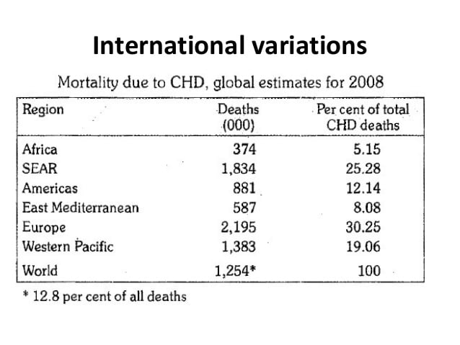

Slide 14
CORONARY HEART DISEASE IN INDIA
Single most important cause of death in India by the year 2015.
Increase in prevalence of CHD in urban areas- 6.4 percent because of change in life styles.

Slide 19
Hormones
-Hyperoestrogenemia
Type A personality
-Restlessness, Impatient, Competitive drive
Alcohol
-High alcohol intake- 75 g or more per day
Oral contraceptives
-Increase in systolic and diastolic blood pressure
Miscellaneous
- Role of dietary fibre, sucrose and soft drinks

Slide 24
PREVENTION OF CHD
HIGH RISK STRATEGY-
Identifying risk:
Blood pressure measurements, serum cholesterol measurement, family history of CHD, Smoking people, Diabetics, women using OCP, obesity.

